Slide 1
Learning with Maximum Likelihood
Note to other teachers and users of these slides. Andrew would be delighted if you found this source material useful in giving your own lectures. Feel free to use these slides verbatim, or to modify them to fit your own needs. PowerPoint originals are available. If you make use of a significant portion of these slides in your own lecture, please include this message, or the following link to the source repository of Andrew’s tutorials: http://www.cs.cmu.edu/~awm/tutorials . Comments and corrections gratefully received.
Andrew W. Moore Professor
School of Computer Science Carnegie Mellon University
www.cs.cmu.edu/~awm awm@cs.cmu.edu
412-268-7599
Copyright © 2001, 2004, Andrew W. Moore
Sep 6th, 2001
Maximum Likelihood learning of Gaussians for Data Mining
Why we should care
Learning Univariate Gaussians
Learning Multivariate Gaussians
What’s a biased estimator?
Bayesian Learning of Gaussians
Copyright © 2001, 2004, Andrew W. Moore
Maximum Likelihood: Slide 2

Slide 2
Why we should care
Maximum Likelihood Estimation is a very very very very fundamental part of data analysis.
“MLE for Gaussians” is training wheels for our future techniques
Learning Gaussians is more useful than you might guess…
Copyright © 2001, 2004, Andrew W. Moore
Maximum Likelihood: Slide 3
Learning Gaussians from Data
Suppose you have x₁, x₂, … x_{R} ~ (i.i.d) N(μ,σ²)
But you don’t know μ
(you do know σ²)
MLE: For which μ is x₁, x₂, … x_{R} most likely? MAP: Which μ maximizes p(μ|x₁, x₂, … x_{R} , σ²)?
Copyright © 2001, 2004, Andrew W. Moore
Maximum Likelihood: Slide 4

Slide 3

Learning Gaussians from Data
Suppose you have x₁, x₂, … x_{R} ~(i.i.d) N(μ,σ²)
But you don’t know μ
(you do know σ²)
Sneer
MLE: For which μ is x₁, x₂, … x_{R} most likely?
MAP: Which μ maximizes p(μ|x₁, x₂, … x_{R} , σ²)?
Copyright © 2001, 2004, Andrew W. Moore
Maximum Likelihood: Slide 5
Learning Gaussians from Data
Suppose you have x₁, x₂, … x_{R} ~(i.i.d) N(μ,σ²)
But you don’t know μ
(you do know σ²)
Sneer
MLE: For which μ is x₁, x₂, … x_{R} most likely?
MAP: Which μ maximizes p(μ|x₁, x₂, … x_{R} , σ²)?
Despite this, we’ll spend 95% of our time on MLE. Why? Wait and see…
Copyright © 2001, 2004, Andrew W. Moore
Maximum Likelihood: Slide 6

Slide 4
MLE for univariate Gaussian
Suppose you have x₁, x₂, … x_{R} ~(i.i.d) N(μ,σ²)
But you don’t know μ (you do know σ²)
MLE: For which μ is x₁, x₂, … x_{R} most likely?
μ = arg max p( x , x ,...x | μ ,σ ² )
mle
1 2 R
μ
Copyright © 2001, 2004, Andrew W. Moore
Maximum Likelihood: Slide 7
Algebra Euphoria
μ = arg max p( x , x ,...x | μ ,σ ² )
mle
1 2 R
μ
=
(by i.i.d)
=
(monotonicity of log)
=
(plug in formula for Gaussian)
=
(after simplification)
Copyright © 2001, 2004, Andrew W. Moore
Maximum Likelihood: Slide 8

Slide 5
Algebra Euphoria
μ = arg max p( x , x ,...x | μ ,σ ² )
mle
1 2 R
μ
R
∏
=
p( x_{i} | μ ,σ )
(by i.i.d)
arg max
μ
2
R
i =1
=
arg max ∑
μ ,σ )
(monotonicity of log)
log p( x |
2
μ
i =1
i
1
2π σ
_{∑ −} i
=
arg max
μ
R
( x − μ )²
(plug in formula for Gaussian)
i =1
2σ ²
=
R
(after simplification)
∑
arg min ( x − μ )
2
μ
i =1
i
Copyright © 2001, 2004, Andrew W. Moore
Maximum Likelihood: Slide 9
Intermission: A General Scalar MLE strategy
Task: Find MLE θ assuming known form for p(Data| θ,stuff)
Write LL = log P(Data| θ,stuff)
Work out ∂LL/∂θ using high-school calculus
Set ∂LL/∂θ=0 for a maximum, creating an equation in terms of θ
Solve it*
Check that you’ve found a maximum rather than a minimum or saddle-point, and be careful if θ is constrained
*This is a perfect example of something that works perfectly in all textbook examples and usually involves surprising pain if
you need it for something new.
Copyright © 2001, 2004, Andrew W. Moore Maximum Likelihood: Slide 10

Slide 6
The MLE μ
μ = arg max p( x , x ,...x | μ ,σ ² )
mle
1 2 R
μ
R
∑
= arg min ( x − μ )
2
μ
i =1
i
= μ s.t.
₀ ₌ ∂LL ₌
∂μ
= (what?)
Copyright © 2001, 2004, Andrew W. Moore
Maximum Likelihood: Slide 11
The MLE μ
μ = arg max p( x , x ,...x | μ ,σ ² )
mle
1 2 R
μ
R
∑
= arg min ( x − μ )
2
μ
i =1
i
∂LL
∂
R
( x − μ )
2
= μ s.t. 0 = _{∂μ}
⁼ ∂μ ∑
i
i =1
− ∑ 2( x_{i} − μ )
i =1
R
R
Thus
_{μ =} 1 ∑
x
R
i =1
i
Copyright © 2001, 2004, Andrew W. Moore
Maximum Likelihood: Slide 12

Slide 7
Lawks-a-lawdy!
_{μ} mle ₌ 1 ∑
R
x
R
i
i =1
The best estimate of the mean of a distribution is the mean of the sample!
At first sight:
This kind of pedantic, algebra-filled and ultimately unsurprising fact is exactly the reason people throw down their “Statistics” book and pick up their “Agent Based Evolutionary Data Mining Using The Neuro-Fuzz Transform” book.
Copyright © 2001, 2004, Andrew W. Moore
Maximum Likelihood: Slide 13
A General MLE strategy
Suppose θ = (θ₁, θ₂, …, θ_{n})^{T} is a vector of parameters. Task: Find MLE θ assuming known form for p(Data| θ,stuff)
Write LL = log P(Data| θ,stuff)
Work out ∂LL/∂θ using high-school calculus
⎛ ∂LL ⎞
⎜ ∂θ
⎟
⎜ 1 ⎟
∂LL
∂θ ⎜
⎜ ∂LL ⎟
=
⎜ ∂θ
⎟
⎜ ∂ M
2 ⎟
⎟
⎜
LL ⎟
⎜ ∂θ
⎟
⎝ n ⎠
Copyright © 2001, 2004, Andrew W. Moore
Maximum Likelihood: Slide 14

Slide 8
A General MLE strategy
Suppose θ = (θ₁, θ₂, …, θ_{n})^{T} is a vector of parameters. Task: Find MLE θ assuming known form for p(Data| θ,stuff)
Write LL = log P(Data| θ,stuff)
Work out ∂LL/∂θ using high-school calculus
Solve the set of simultaneous equations
∂LL ₌ ₀
∂θ₁
∂LL ₌ ₀
∂θ₂
∂ M
LL ₌ ₀
∂θ_{n}
Copyright © 2001, 2004, Andrew W. Moore
Maximum Likelihood: Slide 15
A General MLE strategy
Suppose θ = (θ₁, θ₂, …, θ_{n})^{T} is a vector of parameters. Task: Find MLE θ assuming known form for p(Data| θ,stuff)
Write LL = log P(Data| θ,stuff)
Work out ∂LL/∂θ using high-school calculus
Solve the set of simultaneous equations
∂LL ₌ ₀
∂θ₁
∂LL ₌ ₀
4. Check that you’re at a maximum
∂θ₂
M
∂LL ₌ ₀
∂θ_{n}
Copyright © 2001, 2004, Andrew W. Moore
Maximum Likelihood: Slide 16

Slide 9
A General MLE strategy
Suppose θ = (θ₁, θ₂, …, θ_{n})^{T} is a vector of parameters. Task: Find MLE θ assuming known form for p(Data| θ,stuff)
Write LL = log P(Data| θ,stuff)
Work out ∂LL/∂θ using high-school calculus
Solve the set of simultaneous equations
∂LL ₌ ₀
If you can’t solve them, what should you do?
∂θ₁
∂LL ₌ ₀
4. Check that you’re at a maximum
∂θ₂
M
∂LL ₌ ₀
∂θ_{n}
Copyright © 2001, 2004, Andrew W. Moore
Maximum Likelihood: Slide 17
MLE for univariate Gaussian
Suppose you have x₁, x₂, … x_{R} ~(i.i.d) N(μ,σ²)
But you don’t know μ or σ²
MLE: For which θ =(μ,σ²) is x₁, x₂,…x_{R} most likely?
R
log p( x , x ,...x | μ ,σ ² ) = − R(log π + ¹ log σ ² ) − ¹ ∑ ( x −μ )
2
1 2 R
2
2σ ²
i =1
i
∂LL ₌ 1
∂μ σ ²
R
∑ i
( x −μ )
i =1
∂LL R 1
R
= − +
∑
( x −μ )
2
∂σ ² 2σ ² 2σ ⁴
i =1
i
Copyright © 2001, 2004, Andrew W. Moore
Maximum Likelihood: Slide 18

Slide 10
MLE for univariate Gaussian
Suppose you have x₁, x₂, … x_{R} ~(i.i.d) N(μ,σ²)
But you don’t know μ or σ²
MLE: For which θ =(μ,σ²) is x₁, x₂,…x_{R} most likely?
R
log p( x , x ,...x | μ ,σ ² ) = − R(log π + ¹ log σ ² ) − ¹ ∑ ( x −μ )
2
1 2 R
2
2σ ²
i =1
i
₀ ₌ 1 ∑
_{σ} 2
R
( x −μ )
i
i =1
₀ ₌ ₋ R ₊ 1 ∑
R
( x −μ )
2
2σ ² 2σ ⁴
i =1
i
Copyright © 2001, 2004, Andrew W. Moore
Maximum Likelihood: Slide 19
MLE for univariate Gaussian
Suppose you have x₁, x₂, … x_{R} ~(i.i.d) N(μ,σ²)
But you don’t know μ or σ²
MLE: For which θ =(μ,σ²) is x₁, x₂,…x_{R} most likely?
R
1 1
∑ i i =1
log p( x , x ,...x | μ ,σ ) = − R(log π + log σ ) −
( x −μ )
1 2 R
2
2
2
2σ
2
2
₀ ₌ 1 ∑
R R
_{σ} 2
( x −μ ) ⇒ μ = ¹ ∑ x
i =1
i
R
i =1
i
₀ ₌ ₋ R ₊ 1 ∑
R
( x −μ ) ⇒ what?
2σ ² 2σ ⁴
i
2
i =1
Copyright © 2001, 2004, Andrew W. Moore
Maximum Likelihood: Slide 20

Slide 11
MLE for univariate Gaussian
Suppose you have x₁, x₂, … x_{R} ~(i.i.d) N(μ,σ²)
But you don’t know μ or σ²
MLE: For which θ =(μ,σ²) is x₁, x₂,…x_{R} most likely?
_{μ} mle ₌ ¹ ∑
R
x
R
i =1
i
₌ 1 ∑
σ
2
mle
R
( x −μ )
R
i
mle 2
i =1
Copyright © 2001, 2004, Andrew W. Moore
Maximum Likelihood: Slide 21
Unbiased Estimators
An estimator of a parameter is unbiased if the expected value of the estimate is the same as the true value of the parameters.
If x₁, x₂, … x_{R} ~(i.i.d) N(μ,σ²) then
E[μ ^{mle} ] = E ^{⎡ 1} ∑^{R} x ⎤ = μ
⎢ _{R}
i ⎥
⎣ i =1 ⎦
μ^{mle} is unbiased
Copyright © 2001, 2004, Andrew W. Moore
Maximum Likelihood: Slide 22

Slide 12
Biased Estimators
An estimator of a parameter is biased if the expected value of the estimate is different from the true value of the parameters.
If x₁, x₂, … x_{R} ~(i.i.d) N(μ,σ²) then
E[σ ]= E
⎡ 1
R
⎤
⎡ _{1 ⎛} R
1
R
R
⎞2 ⎤
( x −μ ) = E ⎢ ⎜ ∑ x −
2
mle
⎢ _{R}
∑ i
mle 2
⎥
⎢ R
⎝ i =1
_{σ}2
i
∑ j
x ⎟ ⎥ ≠ σ
⎥
2
⎣ i =1 ⎦
⎣
j =1
⎠ ⎦
_{mle} is biased
Copyright © 2001, 2004, Andrew W. Moore Maximum Likelihood: Slide 23
MLE Variance Bias
If x₁, x₂, … x_{R} ~(i.i.d) N(μ,σ²) then
⎡ _{1 ⎛} R
⎞2 ⎤
E[σ ]= E ⎢ ⎜ ∑ x − ∑ x ⎟ ⎥ = ⎜1 − ⎟σ ² ≠ σ ²
₁ R
⎛ 1 ⎞
2
mle i j
⎢⎣ R ⎝
i =1
R
j =1
⎠
⎥ ⎝
R ⎠
⎦
Intuition check: consider the case of R=1
Why should our guts expect that σ² would be an
underestimate of true σ²? How could you prove that?
mle
Copyright © 2001, 2004, Andrew W. Moore
Maximum Likelihood: Slide 24

Slide 13
Unbiased estimate of Variance
If x₁, x₂, … x_{R} ~(i.i.d) N(μ,σ²) then
⎡ _{1 ⎛} R
⎞2 ⎤
E[σ ]= E ⎢ ⎜ ∑ x − ∑ x ⎟ ⎥ = ⎜1 − ⎟σ ² ≠ σ ²
R
2
mle i
1 ⎛ 1 ⎞
⎢⎣ R ⎝
i =1
R
j =1
j
⎠
⎥ ⎝
R ⎠
⎦
So define
σ
2
unbiased
=
σ
2
mle
So E[σ
2
unbiased
]= σ ²
⎛ 1 ⎞
⎜1 −
⎟
⎝
R ⎠
Copyright © 2001, 2004, Andrew W. Moore
Maximum Likelihood: Slide 25
Unbiased estimate of Variance
If x₁, x₂, … x_{R} ~(i.i.d) N(μ,σ²) then
⎡ _{1 ⎛} R
⎞2 ⎤
E[σ ]= E ⎢ ⎜ ∑ x − ∑ x ⎟ ⎥ = ⎜1 − ⎟σ ² ≠ σ ²
₁ R
⎛ 1 ⎞
2
mle i j
⎢⎣ R ⎝
i =1
R
j =1
⎠
⎥ ⎝
R ⎠
⎦
σ
2
unbiased
=
σ
2
mle
So E[σ ]= σ ²
So define
⎛
2
unbiased
⎜1 − ^{1 ⎞}
_{R} ⎟
⎝ ⎠
₌ 1 ∑
σ
2
unbiased
R
( x −μ )
R −1
i
mle 2
i =1
Copyright © 2001, 2004, Andrew W. Moore
Maximum Likelihood: Slide 26

Slide 14
Unbiaseditude discussion
Which is best?
₌ 1 ∑
σ
2
mle
R
( x −μ )
R
i
mle 2
i =1
₌ 1 ∑
σ
2
unbiased
R
( x −μ )
R −1
i
mle 2
i =1
Answer:
•It depends on the task
•And doesn’t make much difference once R--> large
Copyright © 2001, 2004, Andrew W. Moore
Maximum Likelihood: Slide 27
Don’t get too excited about being unbiased
Assume x₁, x₂, … x_{R} ~(i.i.d) N(μ,σ²)
Suppose we had these estimators for the mean
R
_{μ} suboptimal ₌ ^{1} ∑
x
R + 7 R
i =1
i
_{μ} crap _{= x}
Are either of these unbiased?
Will either of them asymptote to the correct value as R gets large?
Which is more useful?
1
Copyright © 2001, 2004, Andrew W. Moore
Maximum Likelihood: Slide 28

Slide 15
MLE for m-dimensional Gaussian
Suppose you have x₁, x₂, … x_{R} ~(i.i.d) N(μ,Σ)
But you don’t know μ or Σ
MLE: For which θ =(μ,Σ) is x₁, x₂, … x_{R} most likely?
_{µ} mle ₌ ¹ ∑
R
x
R
k =1
k
1
R
R
(x − µ ^{mle} )(x
_{µ} mle ₎^{T}
mle
∑ k
k =1
Σ =
k
Copyright © 2001, 2004, Andrew W. Moore
Maximum Likelihood: Slide 29
MLE for m-dimensional Gaussian
Suppose you have x₁, x₂, … x_{R} ~(i.i.d) N(μ,Σ)
But you don’t know μ or Σ
MLE: For which θ =(μ,Σ) is x₁, x₂, … x_{R} most likely?
R
_{µ} mle ₌ ¹ _{∑ x}
_{µ} mle ₌
R
1 ∑
x
Where 1 ≤ i ≤ m
R k =1
k
i
R
k =1
ki
And x_{ki} is value of the
1
R
_{μ} mle ₎^{T}
i component of x_{k}
R
(x − μ ^{mle} )(x
th
mle
∑
Σ =
k
k
(the i^{th} attribute of the k^{th} record)
And μ ^{mle} is the i^{th}
k =1
i
component of μ^{mle}
Maximum Likelihood: Slide 30
Copyright © 2001, 2004, Andrew W. Moore

Slide 16
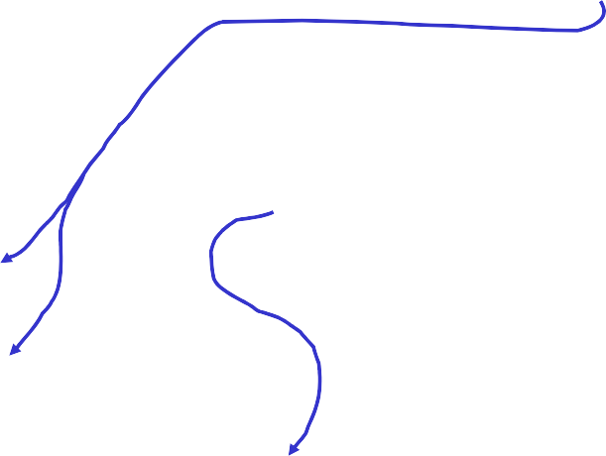
MLE for m-dimensional Gaussian
Suppose you have x₁, x₂, … x_{R} ~(i.i.d) N(μ,Σ)
But you don’t know μ or Σ
MLE: For which θ =(μ,Σ) is x₁, x₂, … x_{R} most likely?
Where 1 ≤ i ≤ m, 1 ≤ j ≤ m
R
_{µ} mle ₌ ¹ _{∑ x}
R
k =1
k
And x_{ki} is value of the i^{th}
component of x (the i^{th}
1
R
∑(x − μ ^{mle} )(x
_{μ} mle ₎^{T}
k
attribute of the k^{th} record)
_{Σ} mle ₌
R
k
k
And σ ^{mle} is the (i,j)^{th}
k =1
ij
component of Σ^{mle}
1
R
R
(x − μ )(x − μ )
σ =
∑ ki i
mle
mle
mle
ij
k =1
kj j
Copyright © 2001, 2004, Andrew W. Moore
Maximum Likelihood: Slide 31
MLE for m-dimensi_{Q}o_{: H}n_{ow}a_{w}l_{ou}G_{ld y}a_{ou}u_{p}s_{rov}s_{e}i_{t}a_{his}n?
Suppose you have x₁, x₂,
… x_{R} ~(i.i.d) N(∝,Σ)
x₁, x₂, … x_{R} most likely?
But you don’t know μ or Σ
A: Just plug through the MLE recipe.
MLE: For which θ =(μ,Σ) is ^{Note how Σmle is forced to be}
symmetric non-negative definite Note the unbiased case
How many datapoints would you need before the Gaussian has a chance of being non-degenerate?
R
_{µ} mle ₌ ¹ _{∑ x}
R
k =1
k
1
R
R
(x − μ ^{mle} )(x
_{μ} mle ₎^{T}
mle
∑
Σ =
k
k
k =1
_{μ} mle ₎^{T}
mle
= ¹ ∑ (x − μ ^{mle} )(x
_{Σ} unbiased ₌ ^{Σ}
R
₁ ₋ 1
R −1
k =1
k
k
Copyright © 2001, 2004, Andrew W. Moore
R
Maximum Likelihood: Slide 32

Slide 17
Confidence intervals
We need to talk
We need to discuss how accurate we expect μ^{mle} and Σ^{mle} to be as a function of R
And we need to consider how to estimate these accuracies from data…
•Analytically *
•Non-parametrically (using randomization and bootstrapping) * But we won’t. Not yet.
*Will be discussed in future Andrew lectures…just before we need this technology.
Copyright © 2001, 2004, Andrew W. Moore
Maximum Likelihood: Slide 33
Structural error
Actually, we need to talk about something else too..
What if we do all this analysis when the true distribution is in fact not Gaussian?
How can we tell? * How can we survive? *
*Will be discussed in future Andrew lectures…just before we need this technology.
Copyright © 2001, 2004, Andrew W. Moore
Maximum Likelihood: Slide 34

Slide 18
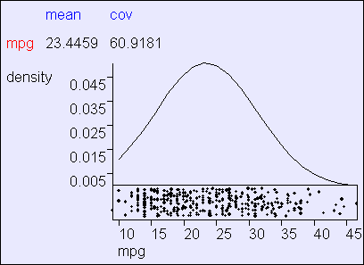
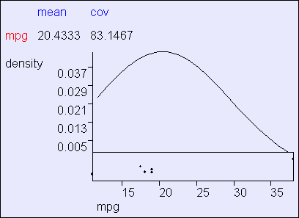
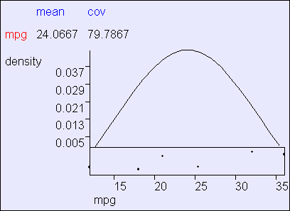
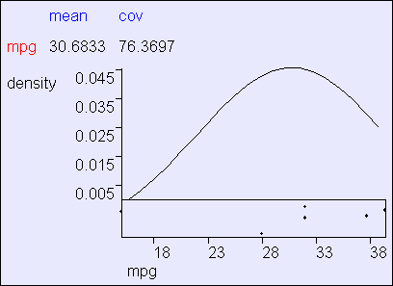
Gaussian MLE in action
Using R=392 cars from the “MPG” UCI dataset supplied by Ross Quinlan
Copyright © 2001, 2004, Andrew W. Moore
Maximum Likelihood: Slide 35
Data-starved Gaussian MLE
Using three subsets of MPG.
Each subset has 6 randomly-chosen cars.
Copyright © 2001, 2004, Andrew W. Moore
Maximum Likelihood: Slide 36

Slide 19
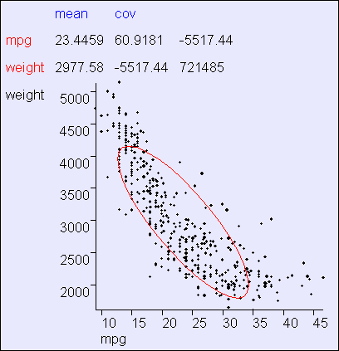
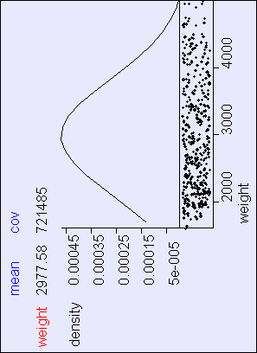
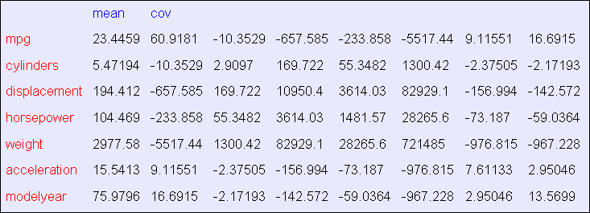
Copyright © 2001, 2004, Andr
Bivariate MLE in action
ew W. Moore
Maximum Likelihood: Slide 37
Multivariate MLE
Covariance matrices are not exciting to look at
Copyright © 2001, 2004, Andrew W. Moore
Maximum Likelihood: Slide 38

Slide 20

Being Bayesian: MAP estimates for Gaussians
Suppose you have x₁, x₂, … x_{R} ~(i.i.d) N(μ,Σ)
But you don’t know μ or Σ
MAP: Which (μ,Σ) maximizes p(μ,Σ |x₁, x₂, … x_{R})?
Step 1: Put a prior on (μ,Σ)
Copyright © 2001, 2004, Andrew W. Moore
Maximum Likelihood: Slide 39
Being Bayesian: MAP estimates for Gaussians
Suppose you have x₁, x₂, … x_{R} ~(i.i.d) N(μ,Σ)
But you don’t know μ or Σ
MAP: Which (μ,Σ) maximizes p(μ,Σ |x₁, x₂, … x_{R})?
Step 1: Put a prior on (μ,Σ) Step 1a: Put a prior on Σ
(ν₀-m-1) Σ ~ IW(ν₀, (ν₀-m-1) Σ ₀ )
This thing is called the Inverse-Wishart distribution.
A PDF over SPD matrices!
Copyright © 2001, 2004, Andrew W. Moore
Maximum Likelihood: Slide 40

Slide 21
Being Bayesian: MAP estimates for Gaussians
ν small: “I am not sure
Su
ppose you have x , x , … x ~(i.i.d) N(μ,Σ)
0
2
about my guess of Σ ₀ ¹“
Σ ^{R} : (Roughly) my best
But you don’t know μ or Σ
0
guess of Σ
M^{ν0}A^{l}Pª:^{rg}W^{e:}h“i^{I}c^{’m}h ^{p}(μ^{re},^{t}Σ^{ty}) ^{s}m^{ur}a^{e}ximizes p(μ,Σ |x₁, x₂, … x_{R})?
about my guess of Σ ₀ “
Step 1: Put a prior on (μ,Σ) Step 1a: Put a prior on Σ
Ε[Σ ] = Σ ₀
(ν₀-m-1) Σ ~ IW(ν₀, (ν₀-m-1) Σ ₀ )
This thing is called the Inverse-Wishart distribution.
A PDF over SPD matrices!
Copyright © 2001, 2004, Andrew W. Moore
Maximum Likelihood: Slide 41
Being Bayesian: MAP estimates for Gaussians
Suppose you have x₁, x₂, … x_{R} ~(i.i.d) N(μ,Σ)
But you don’t know μ or Σ
MAP: Which (μ,Σ) maximizes p(μ,Σ |x₁, x₂, … x_{R})?
Step 1: Put a prior on (μ,Σ) Step 1a: Put a prior on Σ
(ν₀-m-1)Σ ~ IW(ν₀, (ν₀-m-1)Σ ₀ ) Step 1b: Put a prior on μ | Σ
μ | Σ ~ N(μ₀ , Σ / κ₀)
Together, “Σ” and “μ | Σ” define a joint distribution on (μ,Σ)
Copyright © 2001, 2004, Andrew W. Moore
Maximum Likelihood: Slide 42

Slide 22
Being Bayesian: MAP estimates for Gaussians
Suppose you have x₁, x₂, … x_{R} ~(i.i.d) N(μ,Σ)
But you don’t know μ or Σ κ₀ small: “I am not sure
about my guess of μ “
MAP: Which (μ,Σ) maximizes p(μ,Σ |x , x , … x )?
0
1 2 R
μ ₀St:eMpy1b: ePsuttgaupesrisorofonμ (μ,Σ) Step ^{E}1[a^{μ}: ]P⁼ut^{μ}a⁰ prior on Σ
κ₀ large: “I’m pretty sure about my guess of μ ₀ “
(ν₀-m-1)Σ ~ IW(ν₀, (ν₀-m-1)Σ ₀ ) Step 1b: Put a prior on μ | Σ
μ | Σ ~ N(μ₀ , Σ / κ₀)
Notice how we are forced to express our ignorance of μ proportionally to Σ
Together, “Σ” and “μ | Σ” define a joint distribution on (μ,Σ)
Copyright © 2001, 2004, Andrew W. Moore
Maximum Likelihood: Slide 43
Being Bayesian: MAP estimates for Gaussians
Suppose you have x₁, x₂, … x_{R} ~(i.i.d) N(μ,Σ)
But you don’t know μ or Σ
MAP: Which (μ,Σ) maximizes p(μ,Σ |x₁, x₂, … x_{R})?
Why do we use this form
Step 1: Put a prior on (μ,Σ) Step 1a: Put a prior on Σ
(ν₀-m-1)Σ ~ IW(ν₀, (ν₀-m-1)Σ ₀ ) Step 1b: Put a prior on μ | Σ
μ | Σ ~ N(μ₀ , Σ / κ₀)
of prior?
Copyright © 2001, 2004, Andrew W. Moore
Maximum Likelihood: Slide 44

Slide 23
Being Bayesian: MAP estimates for Gaussians
Suppose you have x₁, x₂, … x_{R} ~(i.i.d) N(μ,Σ)
But you don’t know μ or Σ
MAP: Which (μ,Σ) maximizes p(μ,Σ |x₁, x₂, … x_{R})?
Why do we use this form of
Step 1: Put a prior on (μ,Σ) Step 1a: Put a prior on Σ
(ν₀-m-1)Σ ~ IW(ν₀, (ν₀-m-1)Σ ₀ ) Step 1b: Put a prior on μ | Σ
μ | Σ ~ N(μ₀ , Σ / κ₀)
prior?
Actually, we don’t have to
But it is computationally and algebraically convenient…
…it’s a conjugate prior.
Copyright © 2001, 2004, Andrew W. Moore
Maximum Likelihood: Slide 45
Being Bayesian: MAP estimates for Gaussians Suppose you have x₁, x₂, … x_{R} ~(i.i.d) N(μ,Σ) MAP: Which (μ,Σ) maximizes p(μ,Σ |x₁, x₂, … x_{R})? Step 1: Prior: (ν₀-m-1) Σ ~ IW(ν₀, (ν₀-m-1) Σ ₀ ), μ | Σ ~ N(μ₀ , Σ / κ₀) Step 2: _{1 R κ µ + Rx ν = ν + R} _{x = ∑ x µR =} 0 0 R 0 ^{R k =1 κ 0 + R} κ = κ + R k R 0
R (ν + m −1)Σ = (ν + m −1)Σ + ∑(x − x)(x − x)^{T} + R R 0 0 k k k =1 | (x − µ₀ )(x − µ₀ ) T
 | 1/ κ ₀ +1/ R
Step 3: Posterior: (ν_{R}+m-1)Σ ~ IW(ν_{R}, (ν_{R}+m-1) Σ _{R} ), μ | Σ ~ N(μ_{R} , Σ / κ_{R}) Result: μ^{map} = μ_{R}, E[Σ |x₁, x₂, … x_{R} ]= Σ_{R} Copyright © 2001, 2004, Andrew W. Moore Maximum Likelihood: Slide 46

Slide 24
Being Bayesia Suppose you ha MAP: Which (μ,Σ Step 1: Prior: (ν₀-m-1) Σ Step 2: κ _{R} = κ ₀ + R
R (ν + m −1)Σ = (ν + m −1)Σ + ∑(x − x)(x − x)^{T} + R R 0 0 k k k =1 | (x − µ₀ )(x − µ₀ ) T
 | 1/ κ ₀ +1/ R
Step 3: Posterior: (ν_{R}+m-1)Σ ~ IW(ν_{R}, (ν_{R}+m-1) Σ _{R} ), μ | Σ ~ N(μ_{R} , Σ / κ_{R}) Result: μ^{map} = μ_{R}, E[Σ |x₁, x₂, … x_{R} ]= Σ_{R} Copyright © 2001, 2004, Andrew W. Moore Maximum Likelihood: Slide 47
n: MAP estimates for Gaussians
ve x₁, x₂, … x_{R} ~(i.i.d) N(∝,Σ)
) maximizes p(∝,Σ |x₁, x₂, … x_{R})?
IW(ν₀, (ν₀-m-1) Σ ₀ ), ∝ | Σ ~ N(∝₀ , Σ / κ₀)
 | •Look carefully at what these formulae are doing. It’s all very sensible. •Conjugate priors mean prior form and posterior form are same and characterized by “sufficient statistics” of the data. ~ •The marginal distribution on μ is a student-t •One point of view: it’s pretty academic if R > 30
_{1 R} x = ∑ x_{k} ^{R} k =1 | _{µ =} κ ₀µ₀ + Rx ^{R} κ + R 0 | ν _{R} = ν ₀ + R
Where we’re at
Categorical inputs only
Real-valued inputs only
Mixed Real / Cat okay
Inputs Inputs Inputs
Predict category
Joint BC Naïve BC
Dec Tree
Classifier
Density Estimator
Prob- ability
Joint DE Naïve DE
Gauss DE
Regressor
Predict real no.
Copyright © 2001, 2004, Andrew W. Moore
Maximum Likelihood: Slide 48

Slide 25
What you should know
The Recipe for MLE
What do we sometimes prefer MLE to MAP?
Understand MLE estimation of Gaussian parameters
Understand “biased estimator” versus “unbiased estimator”
Appreciate the outline behind Bayesian estimation of Gaussian parameters
Copyright © 2001, 2004, Andrew W. Moore
Maximum Likelihood: Slide 49
Useful exercise
We’d already done some MLE in this class without even telling you!
Suppose categorical arity-n inputs x₁, x₂, …
x_{R}~(i.i.d.) from a multinomial
M(p₁, p₂, … p_{n})
where
P(x_{k}=j|p)=p_{j}
What is the MLE p=(p₁, p₂, … p_{n})?
Copyright © 2001, 2004, Andrew W. Moore
Maximum Likelihood: Slide 50

